Slide 1
The Split and Restoration of the House of Jacob

Slide 2
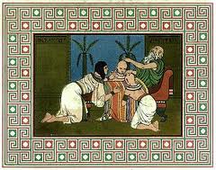
What’s the difference between Israel’s Sons and Tribes?
The Sons were the children of Jacob/Israel
When Joseph saved the family from Famine in Egypt,
Jacob adopted Joseph’s Two Sons Ephraim and Manassah
Thereby giving Joseph’s lineage a DOUBLE PORTION.

Slide 3
"Who are The Twelve Tribes of Israel?” As Priests Levi doesn’t take a portion of land

Slide 4
400 years of Slavery
The Exodus
Betrothed @ Sinai to Israelites and Foreigners who get equal status under the law
Taking the Promised Land
Judges
King Saul
King David
King Solomon

Slide 5
Kingdoms Divided because of Solomon’s Sin
Jeroboam
Solomon’s Servant
Rehoboam
Solomon’s son who listened to younger counsel and increased taxes causing the split prophesied by Ahijah

Slide 6
HOUSE OF JACOB
BOTH KINGDOMS
-House of Israel (northern kingdom-Jeroboam lead )
-Judah & Present Day Jews (southern kingdom- Rehoboam lead)
Because Jacob was the Father of ALL before the split.
House of Judah
Tribes of Judah, Benjamin
(parts of Simeon and Levi)
Jerusalem located in Judah
House of Israel
Called by other names
Joseph, Ephraim, Isaac, Samaria etc it refers to 10 tribes of the Northern Kingdom and Foreigners and Companions of Israel

Slide 7
Israel/10 Tribes/Northern Kingdom Divorced taken captive First and Dispersed
Judah/Jews last 135 years and then taken captive to Babylon …But Later Return

Slide 8
HOUSE OF JACOB
BOTH KINGDOMS
-House of Israel (northern kingdom-Jeroboam lead )
-Judah & Present Day Jews (southern kingdom- Rehoboam lead)
Because Jacob was the Father of ALL before the split.
House of Judah
Tribes of Judah, Benjamin
(parts of Simeon and Levi)
Jerusalem located in Judah
House of Israel
Called by other names
Joseph, Ephraim, Isaac, Samaria etc it refers to 10 tribes of the Northern Kingdom and Foreigners and Companions of Israelites

Slide 9
Judah = now called Jews during return to Land decreed in Nehemiah, Ezra, Esther
So, all Jews are Israelites,
but not all Israelites are Jews.
House of Judah
Tribes of Judah, Benjamin
(parts of Simeon and Levi)
Jerusalem located in Judah

Slide 10
Why wasn’t Judah Divorced? Judah was not divorced because of God's love for Jerusalem and David. This is often referred to as the "Sure Mercies of David" covenant.
2 Samuel 7:12-17
“When your days are fulfilled and you rest with your fathers, I will set up your seed after you, who will come from your body, and I will establish his kingdom. He shall build a house for My name, and I will establish the throne of his kingdom forever. I will be his Father, and he shall be My son. If he commits iniquity, I will chasten him with the rod of men and with the blows of the sons of men. But My mercy shall not depart from him, as I took it from Saul, whom I removed from before you. And your house and your kingdom shall be established forever before you. Your throne shall be established forever.” ’” According to all these words and according to all this vision, so Nathan spoke to David.

Slide 11
Babylon
Daniel prophesies return with other prophets
Medio-Persia
Jews return under Nehemiah, Ezra, during Esther’s Time
Greece
Alexander the Great
Split Between 4 Generals
Antiochas Ephiphanes
Maccabean Revolt
Rome
continues until after Christ

Slide 12
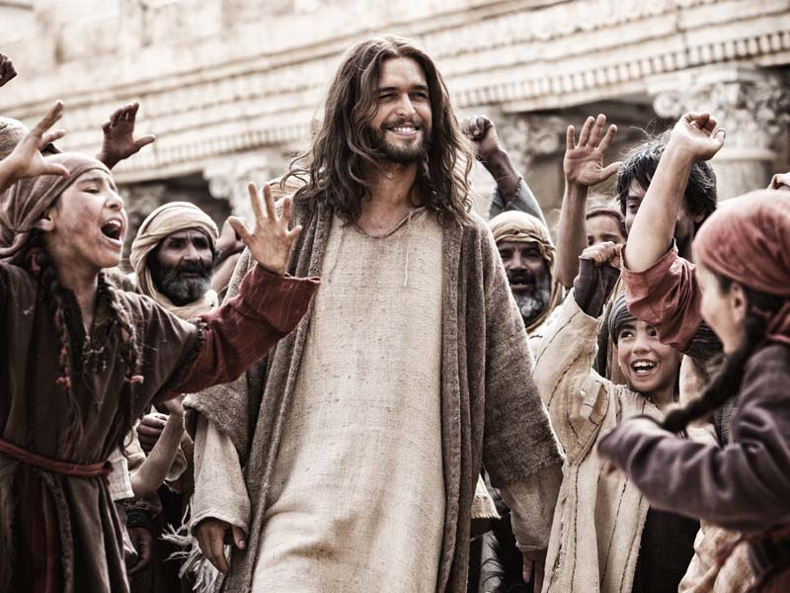
The Kingdoms were still divided
At the Time of Jesus
So, Primarily the People Jesus dealt
with in Jerusalem were from Judah.

Slide 13
One of the primary reasons for Jesus death, burial, resurrection and return is to RESTORE and REDEEM the House of Jacob Luke 1:31-33 And behold, you will conceive in your womb and bear a son, and you shall call his name Jesus. He will be great and will be called the Son of the Most High. And the Lord God will give to him the throne of his father David, and he will reign over the house of Jacob forever, and of his kingdom there will be no end

Slide 14
When Zechariah was praying in holy of holies it was not for a son! It was a traditional prayer called "amidah" (the 18 benedictions) part of that is for the restoration of all of Israel or the House of Jacob. Gabriel said that prayer had been heard!
That's why disciples said “RESTORE the kingdom" vs. “Bring the kingdom”
Acts 1:6 Therefore, when they had come together, they asked Him, saying, “ Lord, will You at this time restore the kingdom to Israel?”
Luke 15 Look at the parables from this perspective (prodigal son) from this perspective.
Northern kingdom is younger son than Judah.
Isaiah 54
Israel=barren woman
Judah=married
Romans 11 is the New Testament Ezekiel 37

Slide 15
Wild Olive Tree=Christians Root=Jesus Natural Branches=Descendants of Israel and Judah
The Apostle Paul was referring to the broken branches of the olive tree of the house of Israel AND the house of Judah in Romans 11 who through Messiah get GRAFTED into the ROOT of Messiah. BOTH EPHRAIM AND JUDAH are GRAFTED into this olive tree and NOT just Ephraim or the non-Jews.
KJV Romans 11:13 For I speak to you Gentiles, inasmuch as I am the apostle of the Gentiles, I magnify mine office
:KJV Romans 11:17 And if some of the branches be broken off, and thou, being a wild olive tree, was grafted in among them, and with them partakest of the root and fatness of the olive tree; So. the "wild branches" are GRAFTED into the olive tree but the "natural branches" are also GRAFTED into this same olive tree.
KJV Romans 11:19 Thou wilt say then, The branches were broken off, that I might be grafted in.
KJV Romans 11:20 Well; because of unbelief they were broken off, and thou standest by faith. Be not highminded, but fear:
KJV Romans 11:23 And they [natural branches] also, if they abide not still in unbelief, shall be grafted in: for God is able to GRAFT THEM in AGAIN.

Slide 16
We are not separate from God’s Chosen People or His Land
Zechariah 14:16-18 Then everyone who survives of all the nations that have come against Jerusalem shall go up year after year to worship the King, the Lord of hosts, and to keep the Feast of Booths. And if any of the families of the earth do not go up to Jerusalem to worship the King, the Lord of hosts, there will be no rain on them.
Daniel 7:14Then to Him was given dominion and glory and a kingdom, That all peoples, nations, and languages should serve Him. His dominion is an everlasting dominion, Which shall not pass away, And His kingdom the one Which shall not be destroyed.

Slide 17
REDEEMED
HOUSE OF JACOB
BOTH KINGDOMS
1.REDEEMED HOUSE OF ISRAEL
2.REDEEMED HOUSE OF JUDAH
REDEEEMED House of Judah
REDEEMED
MESSIANIC JEWS
REDEEMED
House of Israel
REDEEMED DESCENDANTS OF 10 TRIBES
REDEEMED NON-DESCENDANTS/STRANGERS/FOREIGNERS

Slide 18
A New Covenant
Jesus Redeems/Restores the Land to Israel
Leviticus 25:25 “If one of your brethren becomes poor, and has sold some of his possession, and if his redeeming relative comes to redeem it, then he may redeem what his brother sold.
Jesus is the Kinsman Redeemer because He's the brother from the tribe of Judah.
Jesus’ Death Makes It Possible for Israel to be remarried to Jesus during The Wedding Supper of the Lamb
Romans 7:1-3 “Or do you not know, brothers —for I am speaking to those who know the law—that the law is binding on a person only as long as he lives? For a married woman is bound by law to her husband while he lives, but if her husband dies she is released from the law of marriage. Accordingly, she will be called an adulteress if she lives with another man while her husband is alive. But if her husband dies, she is free from that law, and if she marries another man she is not an adulteress”

Slide 19
Jesus’ death ends the covenant/betrothal/contract with both Israel and Judah.
Jesus also becomes the final sacrifice necessary to fulfill the redemption of the people and end the need for atonement again and again through the blood of animals.
Moses was the mediator of the Old Covenant and Jesus is the mediator of the New and better Covenant.
Jesus institutes a NEW COVENANT/BETROTHAL/CONTRACT in which HE has also fulfilled all things.
Hebrews 8-10

